Slide 1
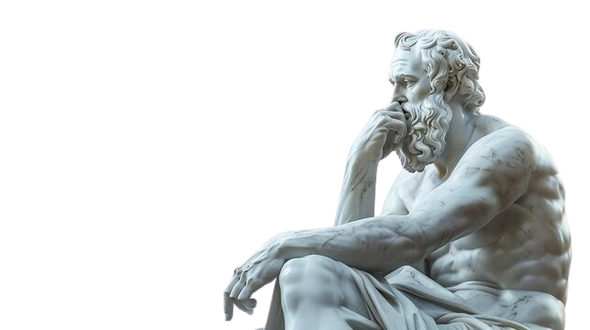
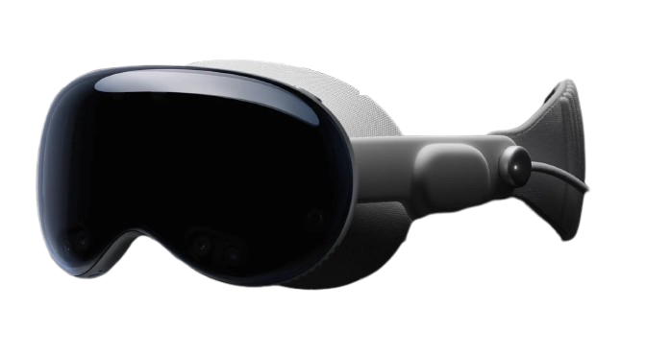
What is Reality?
Student: Chawin Mingsuwan, HPC-DES
Mentor: Chloe Keilers, HPC-DES
Co-Mentor: Jesus Pulido, CCS-3
08/07/25
LA-UR-25-27818
For Internal LANL use only

Slide 2
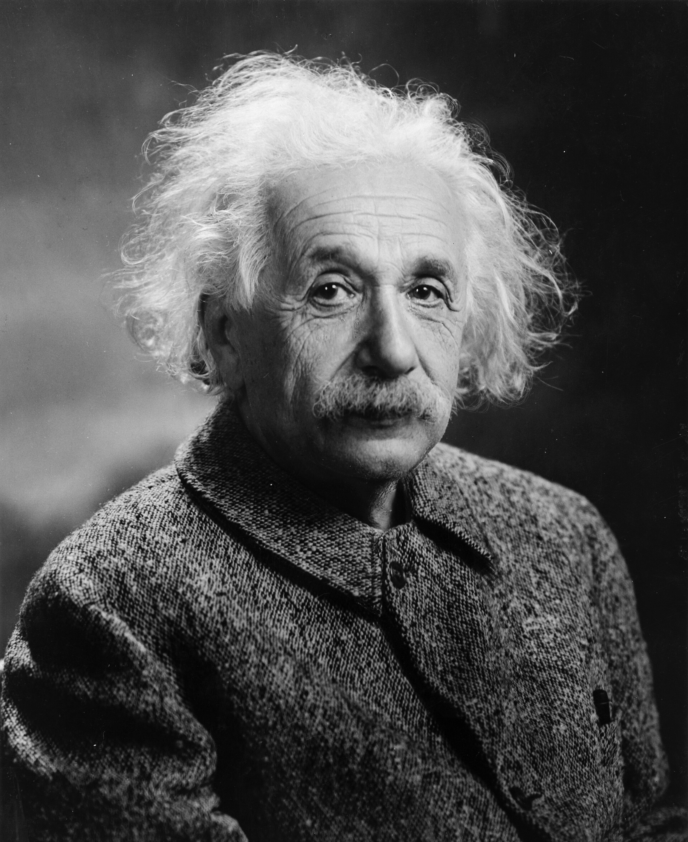
“Reality is merely an illusion, albeit a very persistent one.”
-Albert Einstein
Photograph by Oren Jack Turner, Princeton, N.J. - T

Slide 3
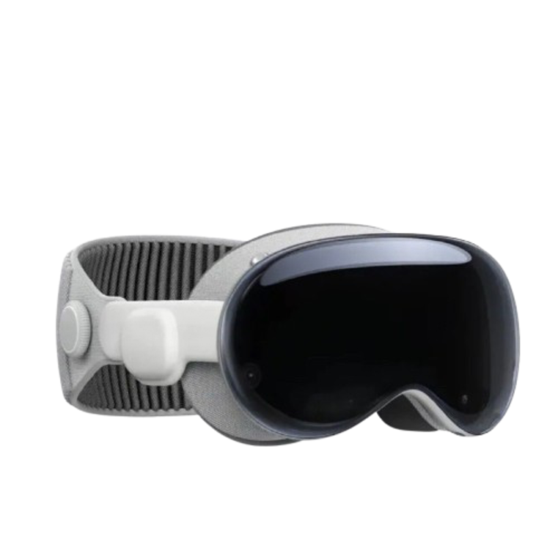
Apple Vision Pro

Slide 4
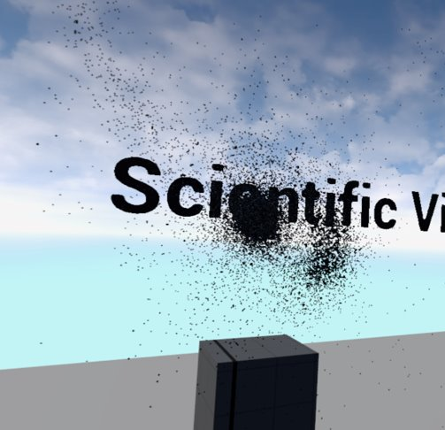
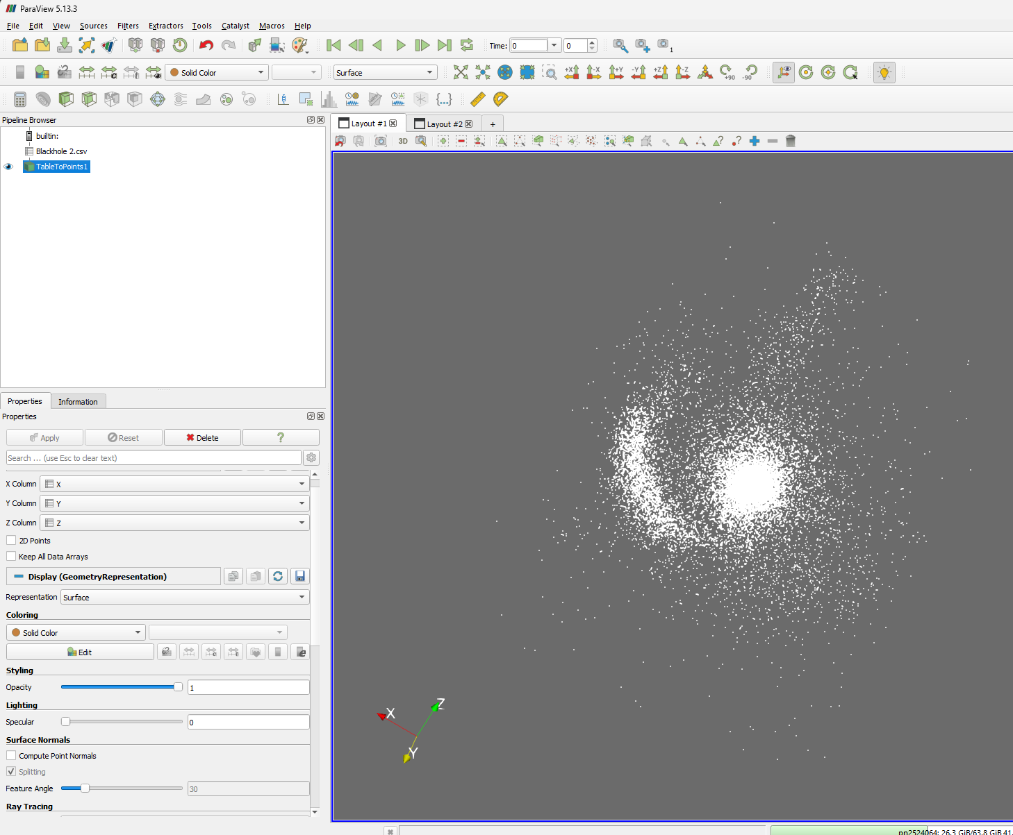
Black Hole as a Point Cloud from Bluetides Qusar
Black Hole in Virtual Reality

Slide 5
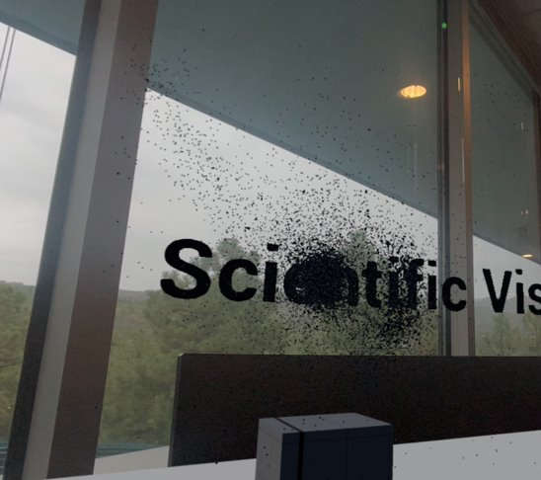
Augmented Reality
Virtual Reality

Slide 6
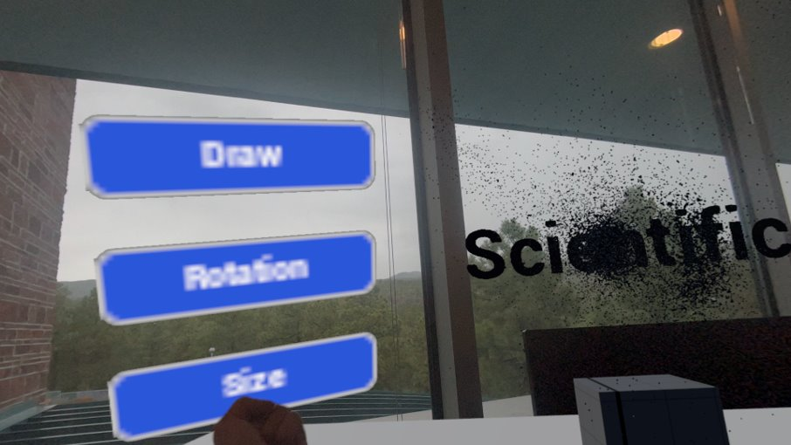
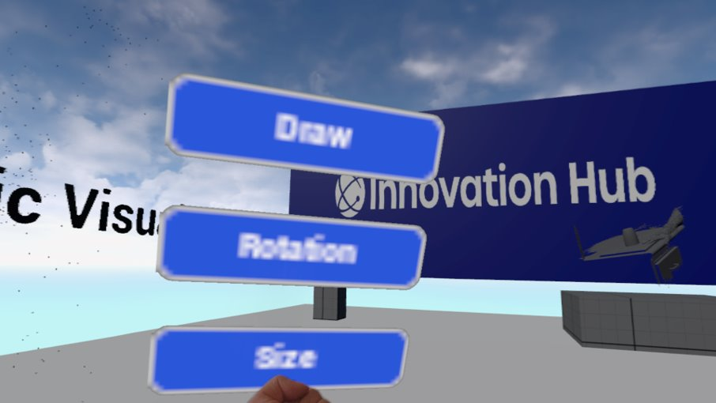
Augmented Reality
Virtual Reality

Slide 7
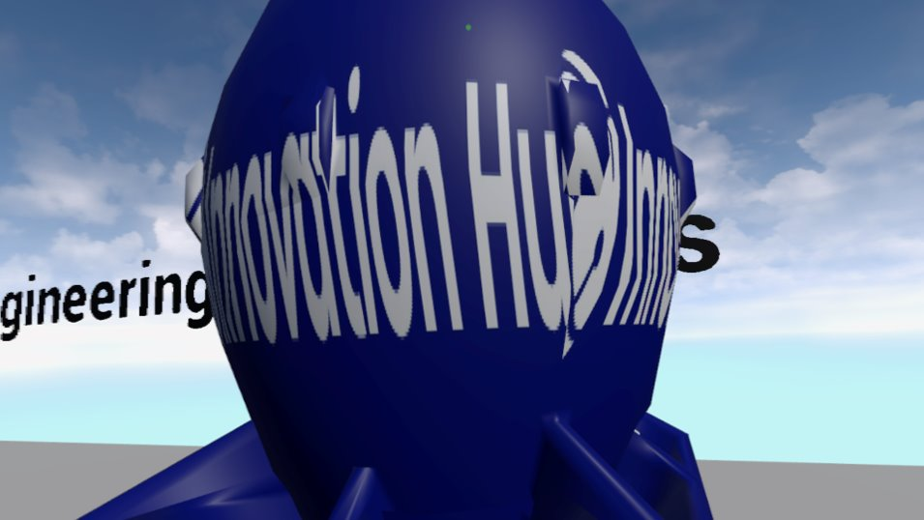
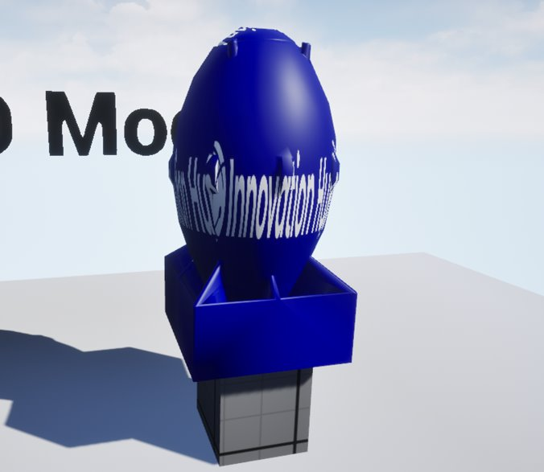
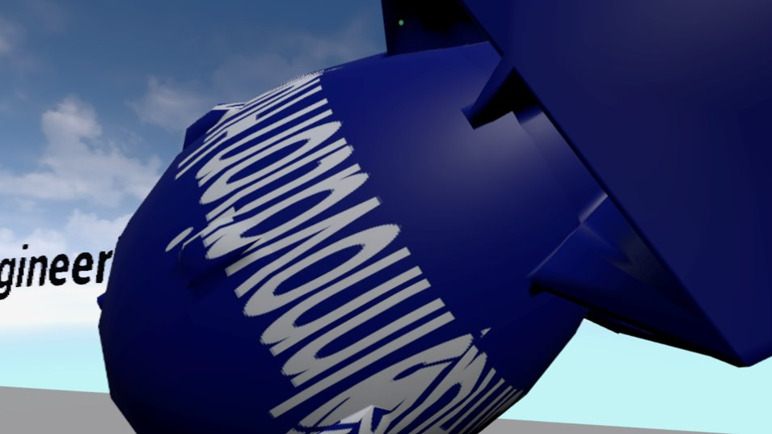
Increased Size
Rotated
Original Size & Position of Fatman

Slide 8
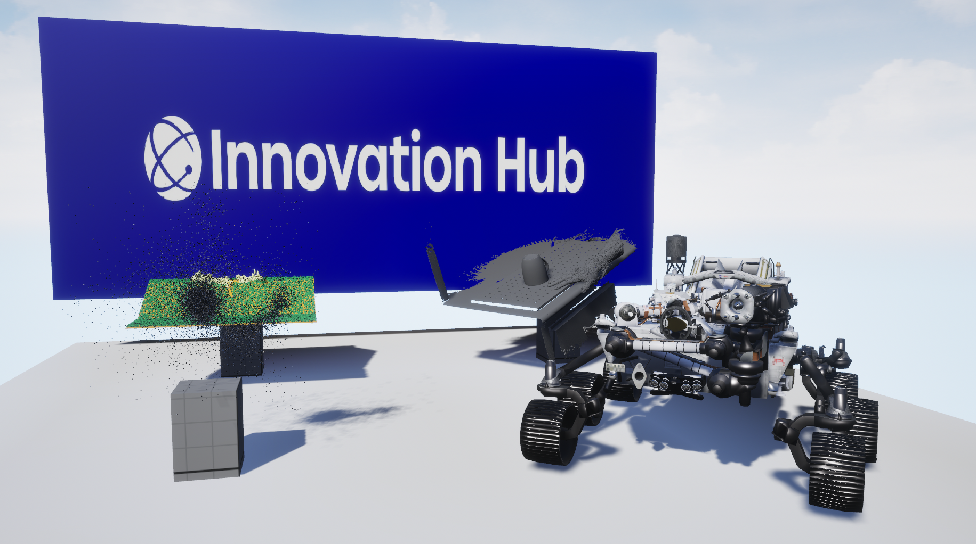
Notes:
Applications Slides

Slide 9
The End
Come Check out the poster in the Next Room!!
Reimagining Reality: XR Visualization Workflows for Science and Engineering
For Internal LANL use only

